Slide 1
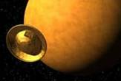
The Huygens probe was part of the larger Cassini mission to Saturn.
The probe piggy-backed aboard the Cassini spacecraft for 7 years, then was released on December 25th 2004, toward it's goal -Titan -Saturn's largest moon.

Slide 2
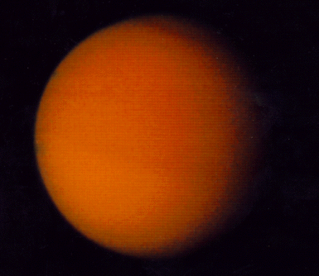
Target: Titan
Titan is a moon larger than the planet Mercury and 40% the size of Earth. However, it is mostly made of ice, with some rock in the core.
Titan is the only world other than Earth to have a nitrogen rich atmosphere. In fact Titan's atmosphere is 1.5 times thicker than Earth's.
The temperature and pressure on Titan is enough that methane could be either a solid, liquid or gas. However, we don't know because we cannot see the surface. Thick clouds of smog are in the way!

Slide 3
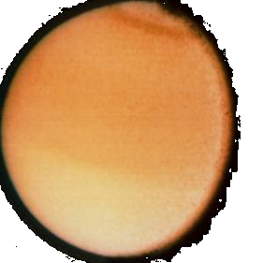
Target: Titan
Here are some of the large-scale questions scientists are trying to answer:
Are there lakes or oceans of methane?
Are there rivers or signs of erosion?
What does the surface look like?
Does it rain on Titan?
Are there lightning strikes?
What are the clouds made of?
Is Titan a cool and dark place?
Is Titan similar to the early Earth?

Slide 4
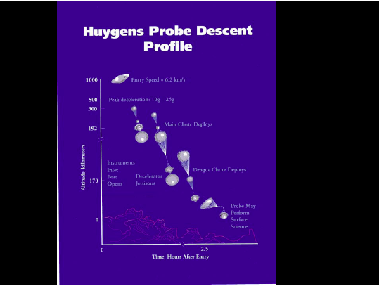
The probe was designed to descend to the surface, taking data as it went.
A parachute immediately opened, slowing the probe for a soft landing.

Slide 5
The Huygens probe had six science instruments:
Descent imager
  (takes visible and infra-red images)
Atmospheric Structure Instrument
  (takes pressure, density, temperature and other data with changing altitude)
Aerosol collector
  (traps cloud particles to analyze)
Gas Chromatograph/ mass spectrometer
  (analyzes the composition of the trapped clouds particles)
Doppler wind Experiment
  (measures probe's descent speed and wind turbulence)
Surface science package
  (detects composition and properties of the surface)

Slide 6
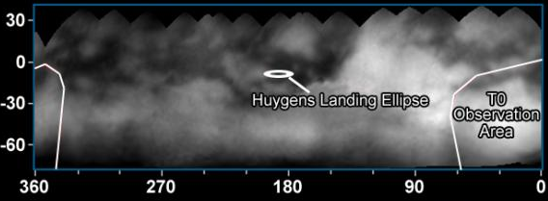
This is Cassini's first map of Titan, with the landing area shown. The landing area was chosen, based on a bright region seen by Hubble.

Slide 7
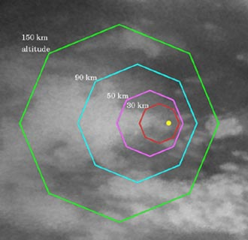
This is a close up view from Cassini that targeted Huygens on it's way.
The lines show the areas where Huygens took images as it descended.
The yellow dot was the predicted landing spot
(if no heavy turbulence sent it elsewhere).

Slide 8
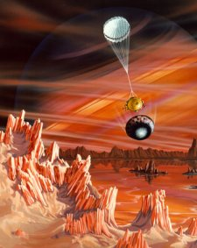
No one knew what Huygens would land on: Icy plains, mountains, methane lakes or tarry organic sludge.
  -would it go crunch, splash or squish?
The scientists would be very happy if they could get just a few minutes of data collection from the surface. A soft landing would allow data gathering for up to half an hour before the probe shuts down from the extreme cold.

Slide 9
To find out about the Huygen's discoveries, return to the main menu and click on the link 'Huygens Mission Results'.
To find more about the Cassini mission's discoveries so far, return to the main menu and click Cassini Mission Results: Saturn, Saturn's Rings , Saturn's Moons , or Titan.

